Slide 1
WORDS GUESSER
Presented By:
Abdul Rehman nazeer (22k4078)

Slide 2
INTRODUCTION
Our project takes any unsorted words file, then sort it efficiently.
After that it will display some input formats.
According to these five formats user will enter the word which he wants to guess, but here comes our main focus of our work:
The word he will enter will not be completed ,as our input format says and our project will find all the words completely which user wants to search with the help of trees.

Slide 3
TOOLS USED:-
Language:- cpp
Compiler:- dev c++
Libararies:-
#include <bits/stdc++.h>
#include<conio.h>
#include<windows.h>
TREE:- trie
Sorting:- MERGE SORT
SEARCHING:- TRIE

Slide 4
WHY C++?
C++ is more suitable for large scale software projects such as management system which includes multi-task, multi-factor and multi requirement.
By using encapsulation, we can encircle the process and data so that each functional module is independent of each other
We could then successfully restrict the modification and maintenance of the program to the class, which ultimately makes thing easier.
By applying inheritance, we could share attributes from parent classes to improve code’s reusability.
By making use of polymorphism, it provides a way to abstract the complicated relationships.

Slide 5

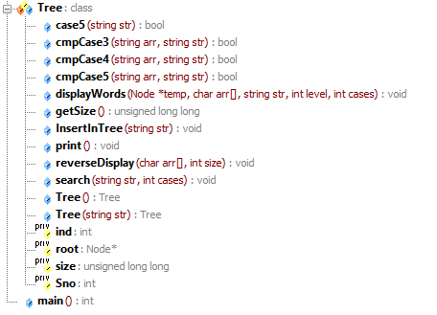
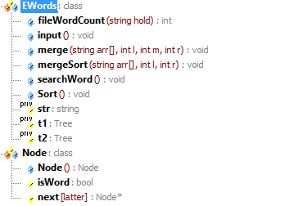
FUNCTIONS USED IN PROJECT

Slide 6
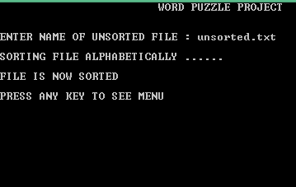
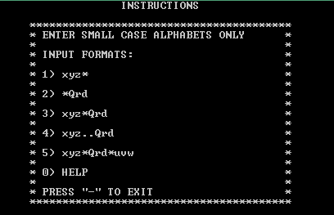


Slide 7





THANK YOU!!!

